Slide 1
Quality Center Reverse KT
Infosys 2019
17^{th July, 2019 Wednesday}

Slide 2
Agenda
Introduction
Architecture Overview
Application Workflow
Application Overview
Quality Center
→ Application URL/ Login View
→ Quality Center Dashboard
→ Application Functionality
Stakeholders Information
Most Common Issues
Support Contacts

Slide 3
Introduction
Quality Center Or HP ALM (Application Life Cycle Management)
It is a test management tool offered by Micro Focus
HP ALM that supports various phases of the software development life cycle
It is a web based tool that helps organizations to manage the application lifecycle
→ Project Planning
→ Project tracking
→ Test Resources, Test Plan
→ Test Lab, Test Runs
→ Defects management and Dashboard view

Slide 4



Application Workflow
End User
ICT Service Desk
Support Team

Slide 5


Architeture Overview
End User
Quality Center (HP ALM)
https protocal
https://qc.posti.com/qcbin/start_a.jsp
Site to Site VPN connectivity
QC server (Posti)
One share Azure Cloud

Slide 6
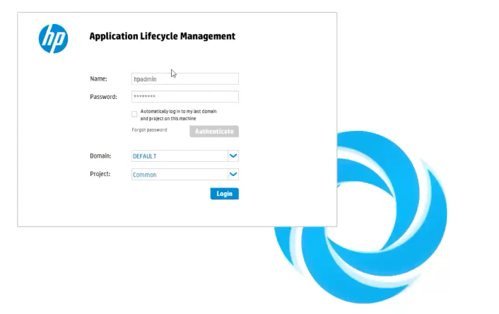
Application Overview: Quality Center
Application URL:
→ https://qc.posti.com/qcbin/start_a.jsp
Login View:

Slide 7
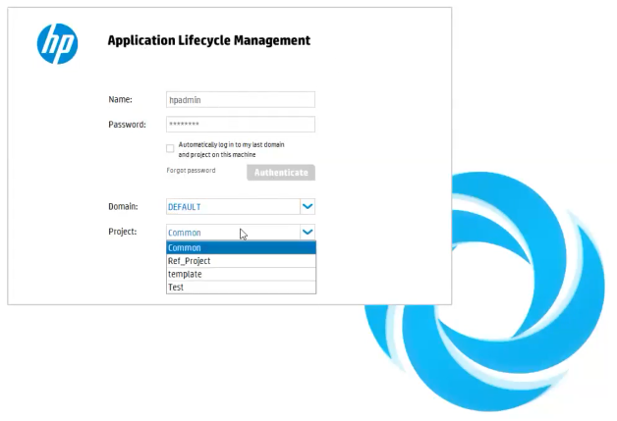

Slide 8
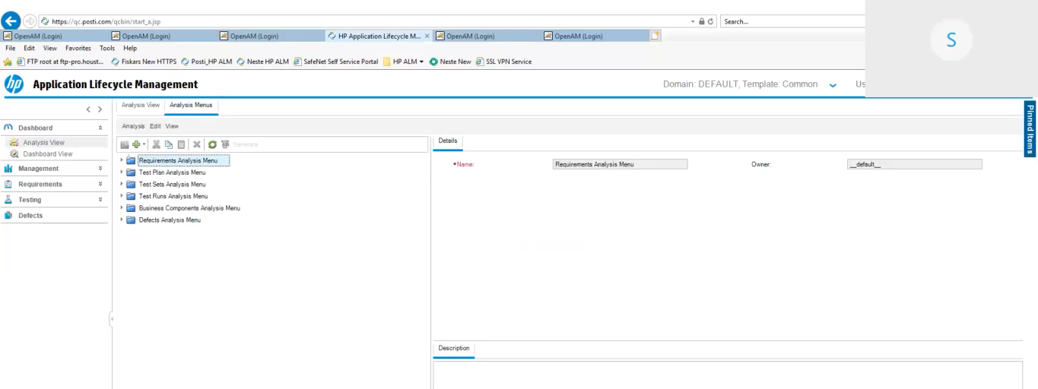
HP ALM Dashboard: Landing Page

Slide 9
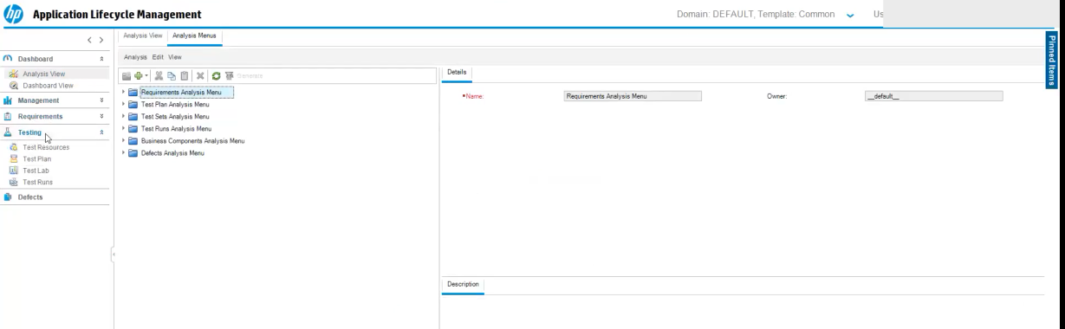
HP ALM → Testing View

Slide 10
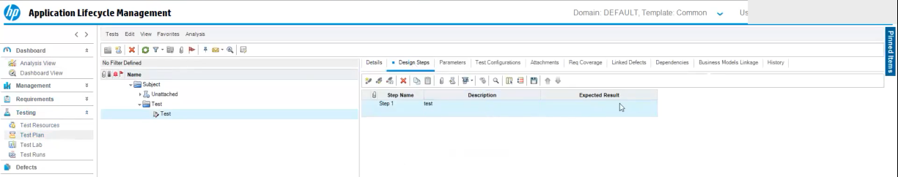
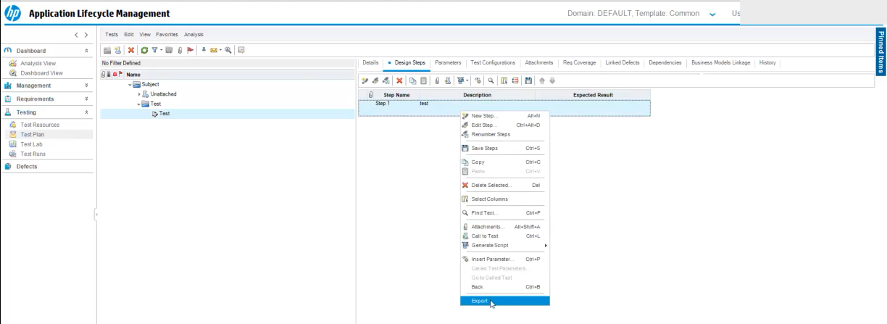
HP ALM → Testing → Test Plan View

Slide 11
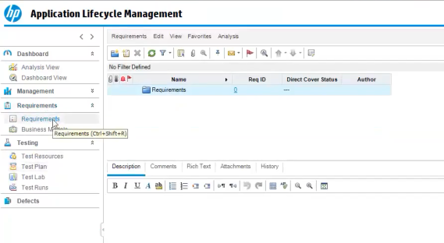
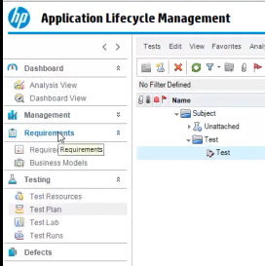
HP ALM → Requirements Dashboard

Slide 12
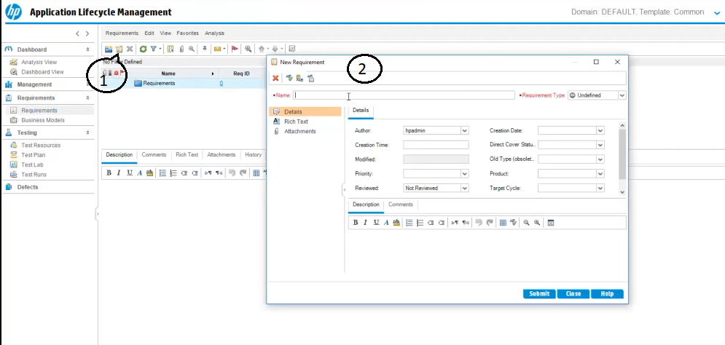
HP ALM → Requirements Dashboard → New Requirements

Slide 13
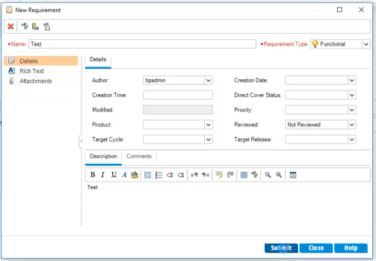
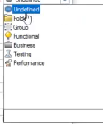
HP ALM → Requirements Dashboard → New Requirements
2
3

Slide 14
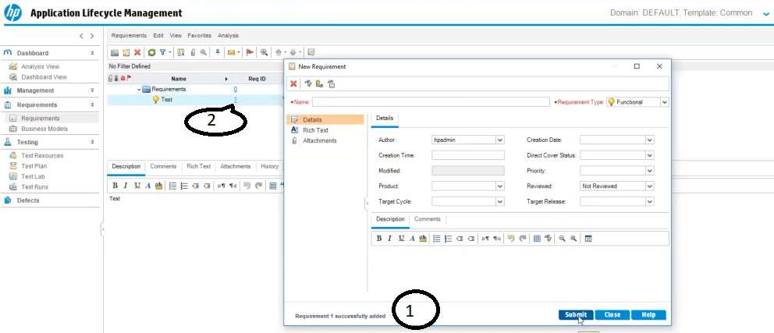
HP ALM → Requirements Dashboard → New Requirements → Created

Slide 15
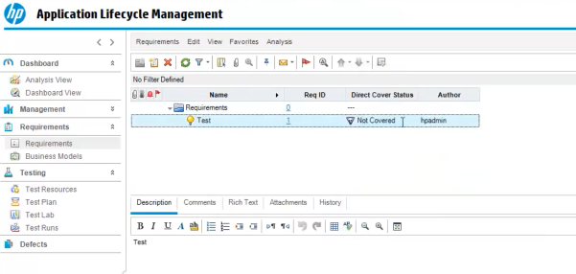
HP ALM → Requirements Dashboard → New Requirements → Requirement View
One Requirement Created but Direct Cover status is “ Not Covered”

Slide 16
Stakeholders Information
The various stakeholders involved in a typical project are –
→ Tester
→ Developer
→ Project Managers
→ Product Owners

Slide 17
Most Common Issues
Request for access the Quality Center Application
→ Create a new Quality Center account request
Unable to access the view tabs in Quality Center(HP ALM)
e.g. → Dashboard view
→ Requirements
→ Test plan and etc.
Customisation Requests in Quality Center
Access and Errors in Quality Center

Slide 18
Support Contacts
ICT Service Desk from Posti
→ ictservicedesk@posti.com
Sogeti FI from Sogeti Oy
→ posti-testtoolsupport.fi@sogeti.com

Slide 19
☺
Thank You

